Slide 1


DISASTER MANAGEMENT....

Slide 2

Disaster Management: Its Problems:
Effective disaster management requires overcoming a range of complex challenges, from poor coordination to limited resources. Understanding and addressing these problems is crucial to improving emergency response and resilience.

Slide 3

Introduction:
Title: What is Disaster Management?
Content:
Definition: Disaster management is the organization, planning, and application of resources to minimize the impact of disasters.
Objective: To protect life, property, and the environment through preparedness, response, recovery, and mitigation.

Slide 4
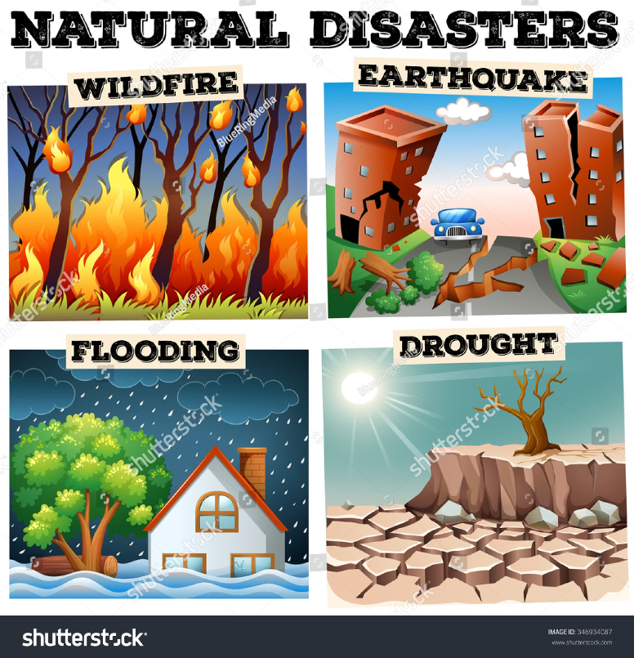
Types of Disasters:
Natural Disasters: Earthquakes, hurricanes, floods, wildfires, etc.
Man-Made Disasters: Industrial accidents, nuclear incidents, terrorism, etc.
Complex Emergencies: Situations where both natural and human factors cause crises, such as wars or widespread violence.

Slide 5
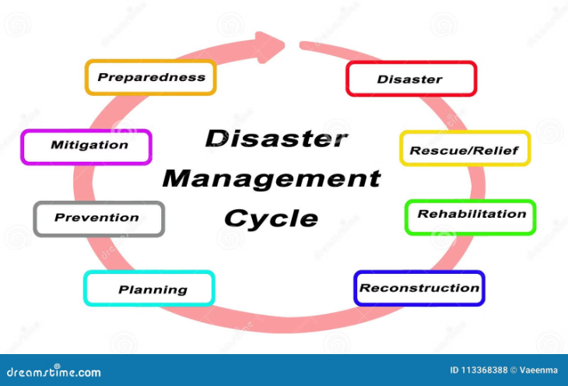
Disaster Management Phases:
Title: Phases of Disaster Management:
Content:
Preparedness: Planning, training, and readiness activities.
Response: Immediate actions to save lives and protect property.
Recovery: Restoring normalcy and rebuilding.
Mitigation: Reducing the impact of future disasters.

Slide 6
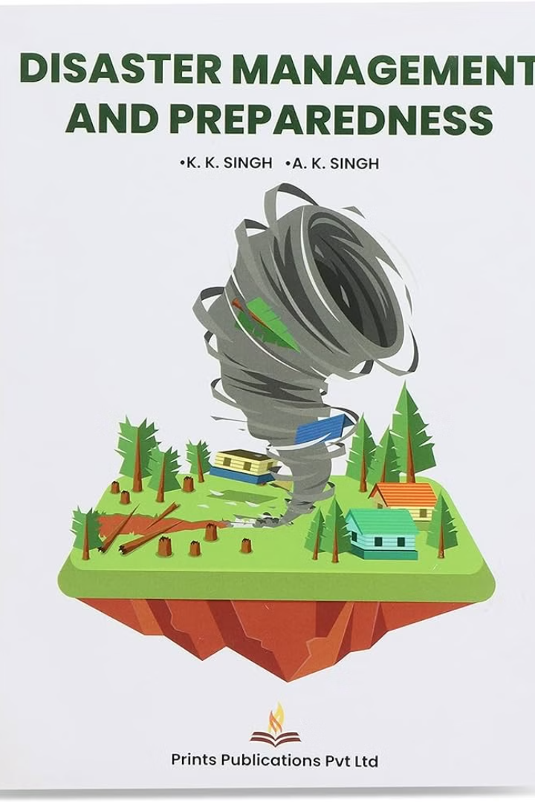
Preparedness:
Title: Preparedness:
Content:
Developing emergency plans.
Conducting drills and training exercises.
Stockpiling supplies and equipment.
Community awareness and education.

Slide 7

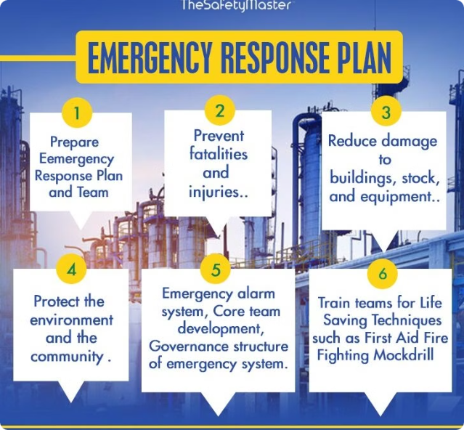
Response:
Title: Response:
Content:
Activation of emergency plans.
Coordination among agencies and organizations.
Deployment of resources and personnel.
Providing immediate relief and medical aid.

Slide 8

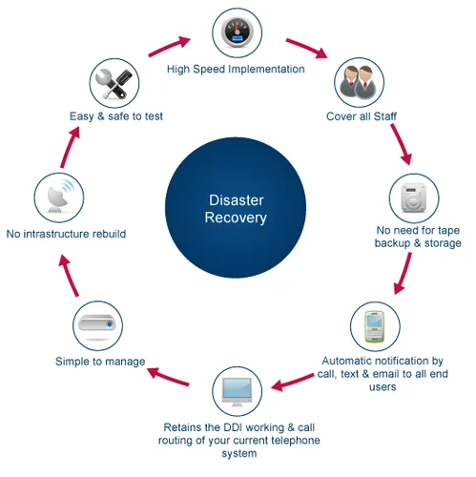
Recovery:
Title: Recovery:
Content:
Assessing and repairing damage.
Providing support to affected individuals and communities.
Rebuilding infrastructure and services.
Evaluating the response and recovery efforts for future improvements.

Slide 9
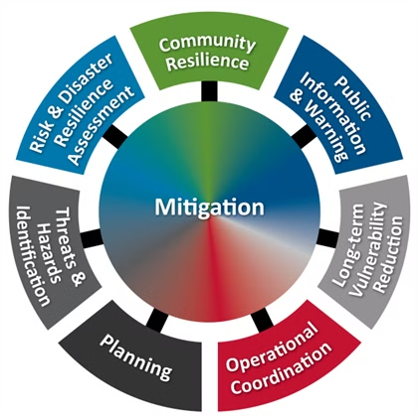
Mitigation:
Title: Mitigation:
Content:
Implementing building codes and land-use planning.
Creating early warning systems.
Educating the public about risk reduction.

